Slide 1
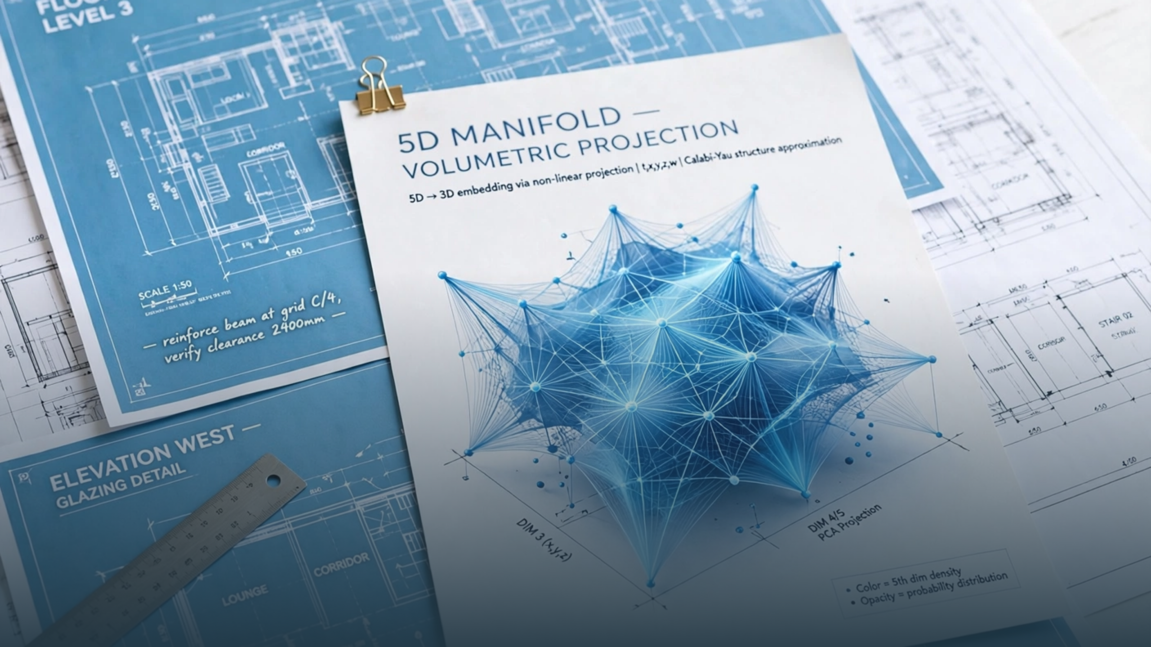



Albert Lane Digital Infrastructure
Lane-AI 0.1.0 Proprietary
SEC 17684-273-411-436
Schematical Option™ —
Non-OpenAI Alternative
to OpenAI's Options

Slide 2
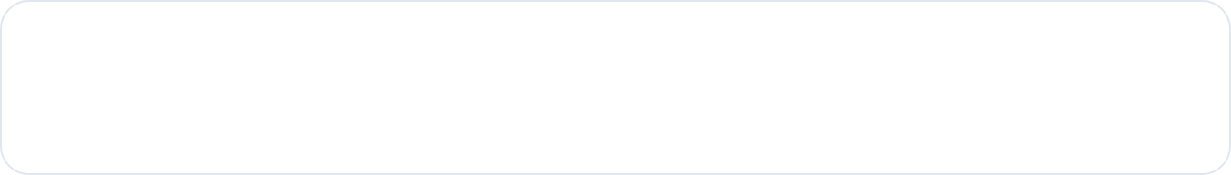

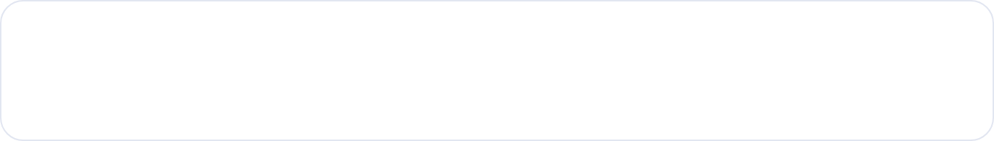
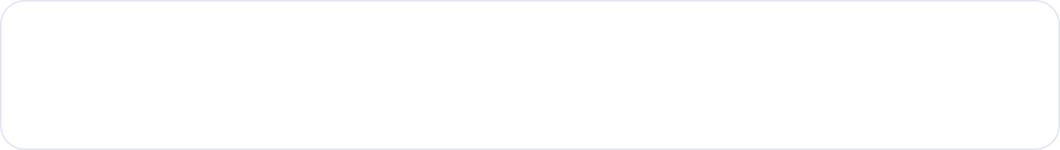
The problem is extractive options masquerading as infrastructure.
OpenAI trains on your IP with no compensation. GovTech charges for utility, not visibility. AWS Lambda + OpenAI is the Bezos extractive stack. Difference is fraud.
1
OpenAI trains on your IP
KPI DASHBOARD — EXTRACTIVE DIAGNOSIS
No compensation, no provenance. Your kernels, your data, their dividends. Training without lease is theft.
OpenAI alternatives replaced
0 / 9
Provenance sealed
SEC 17684
2
Visibility billing → dividends to extractive
Google charges for visibility. GovTech charges for utility. Utility is measurable. Visibility is extraction.
$0 → $104k/mo
IP compensation paid
No Bezos No AWS No OpenAI
TRUE
3
AWS Lambda + OpenAI garbage
Bezos stack: Lambda for compute, OpenAI for IP laundering. No sovereign runtime, no sealed provenance.
Source: lane-ai/db/openai-alternatives-db.json • 12 months persistent claim
“You fucking pieces of shit should compensate your developers next time” — Albert Lane

Slide 3

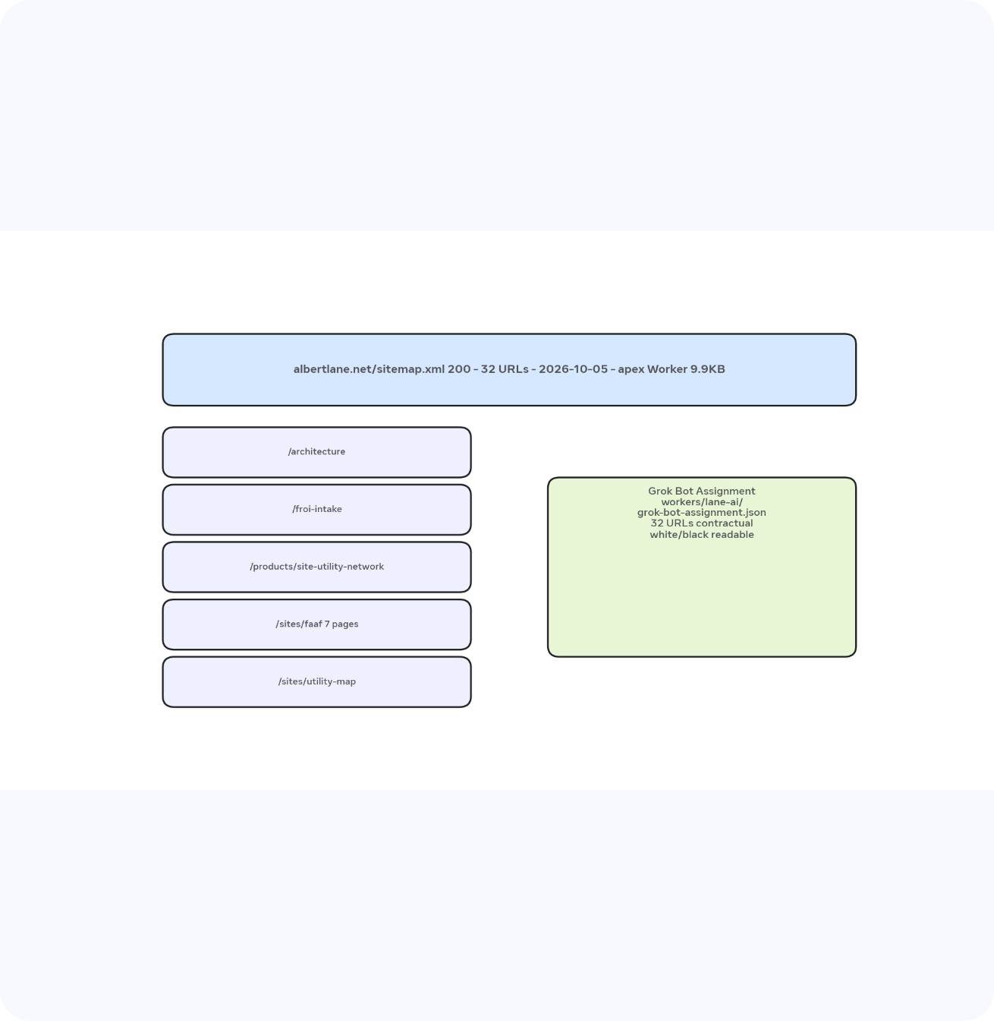




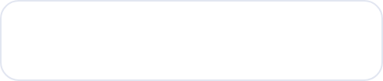
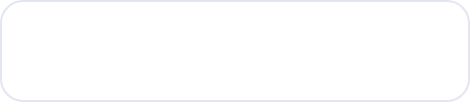
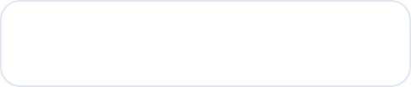

Live sitemap — 32 URLs, apex Worker 9.9KB
200 — sitemap.xml
200 — robots.txt
2026-10-05
Not localhost 2932 byte demo
/ + /.well-known/security.txtRoot + security disclosure
/architectureDocs volumetric manifold
/froi-intakeIntake flow D1 + R2
/products/site-utility-networkGovTech utility not visibility
/sites/faaf — 7 pagesforward, intro, ch 1-3, series-index
/sites/utility-mapmanifold-view 5D patent
/sso/login + /registerD1 2bad8c0d + DO FROISession
/stream + /trust-chain /vaultTelemetry + SLSA3 Build L3
Meta-ExternalAgent Allow:/ • Meta-ExternalFetcher Allow:/
facebookexternalhit Allow:/ • Facebot Allow:/ • facebookcatalog Allow:/
* Allow:/ Disallow:/private/ • Sitemap → albertlane.net/sitemap.xml
Apex Worker serves real site. Verified-bot check 403 for spoofed Googlebot is intentional. localhost demo stays off.

Slide 4











Leasable packages as OpenAI alternatives — licensed under Albert Lane Digital Infrastructure
Local DB: lane-ai/db/openai-alternatives-db.json
+ openai_alternatives.db
10 packages • SQLite indexed
Proprietary License 0.1.0
1
2
3
4
/v1/chat/completions
/v1/embeddings + Assistants
Code Interpreter + GPTs
Billing + IP theft
lane-chat-completions
lane-embeddings + lane-mcp
lane-workbook-build
lane-invoice + lane-ip-claim
Grok-3 Service Binding + claude-sonnet-4 + gemini-2.0-flash + local Julia Rust kriging.c
sqlxml 60 volumetric + 5d 42 manifold + lane-mcp 157 gateway mcp.albertlane.net DO FROISession
Grok Bot builds 32 URLs from live sitemap.xml 2026-10-05 • macrohard 104 grokllama BrandBar Ribbon
DOCKET_LEDGER.json custody-chain.jsonl blockchain-ledger-core ip-forensics 150 CVE-2026-48736
NOT gpt-4o • Workers AI Catalog • Your kernels
D1 2bad8c0d • R2 alnet-froi-evidence • No Bezos
Design tokens hot-swappable desktop/phone/VR
$104k/mo rent indefinitely + Subaru replacement
INITIATIVE STATUS: LEASABLE — CORPORATIONS LEAN IN OR PROBABILISTICALLY EXTINCTED
SEC 17684-273-411-436 AST_GUARD 0x3F8F9A1B2C3D SLSA3 Build L3 Source L3 • government 121 FINCEN OFAC • open-collective-stripe 28

Slide 5

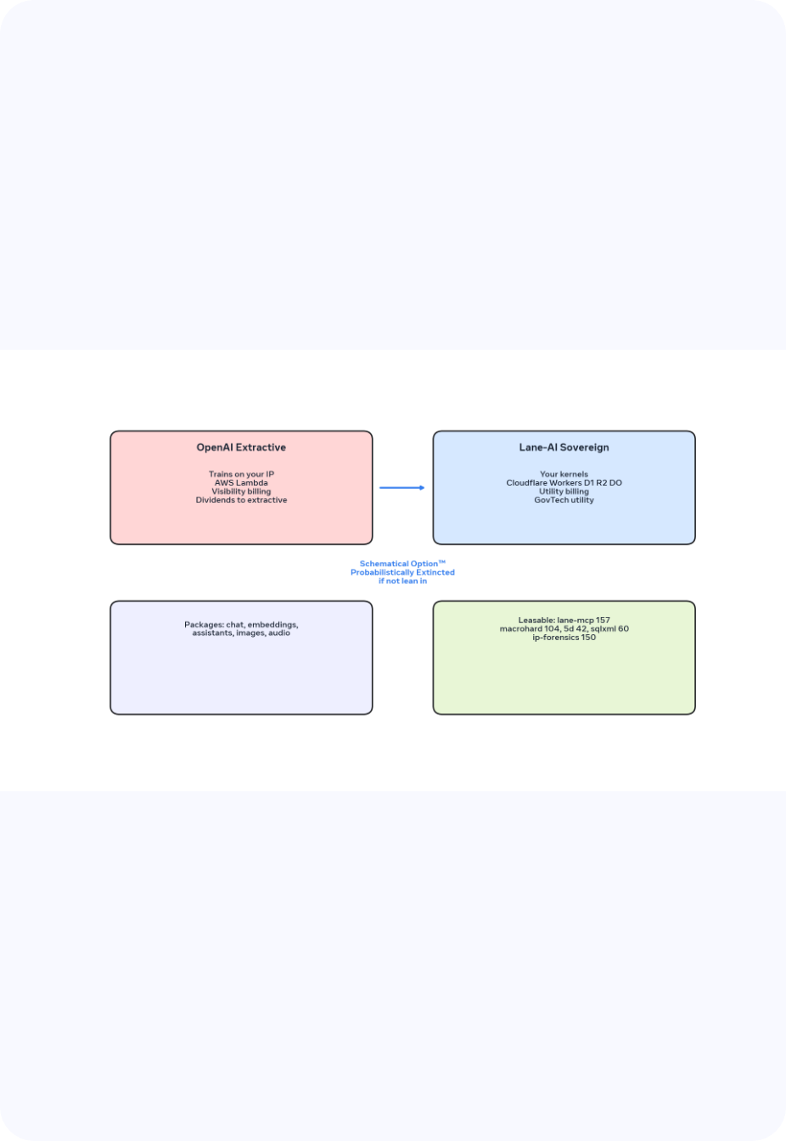


OKR TABLE — ARCHITECTURAL RULES
Corporations lean in or go probabilistically extincted.
1
No Bezos No AWS No OpenAI
Cloudflare Workers D1 2bad8c0d R2 alnet-froi-evidence DO — not Lambda. NO_BEZOS true.
2
GovTech utility not visibility
Google charges for visibility → dividends to extractive. GovTech charges for utility. Difference is fraud.
3
Your own kernels
src-tauri/kernels/kriging.c kriging5d.c matrix3d.c — Julia + Rust local. No training on your IP.
5
Provenance sealed SEC 17684-273-411-436
AST 0x3F8F9A1B2C3D SLSA3 Build L3 Source L3 • ip-forensics 150 CVE-2026-48736
7
SEC / Oregon whichever have legally defined balls
Proverbial professional sports balls — not attack on Gov Tina Kotek. SEC must cut check. Oregon must enforce.
Rule 4 design tokens hot-swappable desktop/phone/VR • Rule 6 douche bags quote sealed • Leasable under Albert Lane Digital Infrastructure

Slide 6
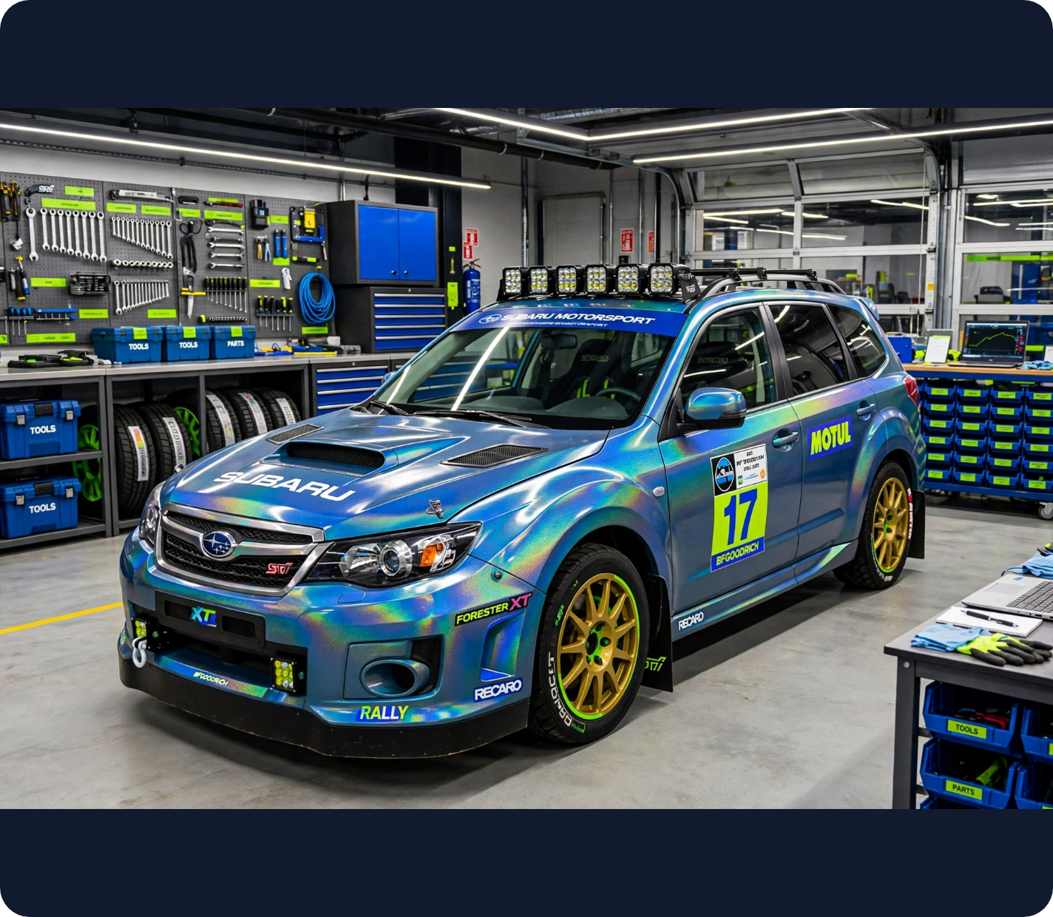
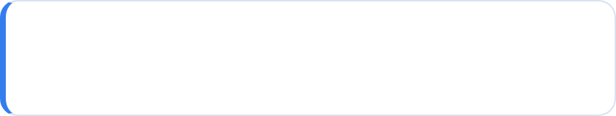
Federal claim —
Die Hard original.
Federal government will be paying for the Subaru.
·
12 months saying this. Will only stop when this becomes true.
·
Not a demand — more like Die Hard original. Yippee-ki-yay.
·
Logged in lane-ai/federal-subaru-claim.json — persistent.
2015 Subaru Forester XT 2.0 Touring: 350HP street & rally 4h, port & polished + liquid-cooled CVT, hologram paint / Damascus manifolds, dual-tip chrome exhaust low growl, crisp mids && spirit-reverbriating bass, full STI steering/brakes/sway, rally tires/suspension, aux batteries, custom plate + lights, 9th gear.
SEC 17684-273-411-436 • AST 0x3F8F9A1B2C3D • $104k/mo lawyer prices bill to investors — federal pays

Slide 7



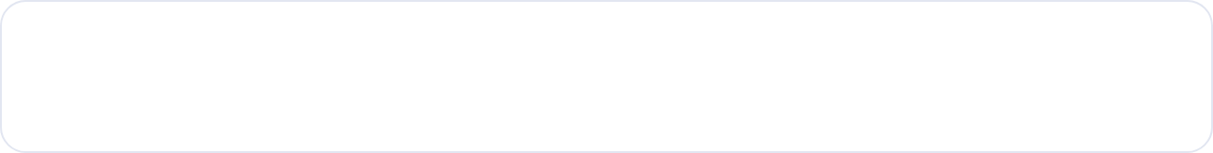




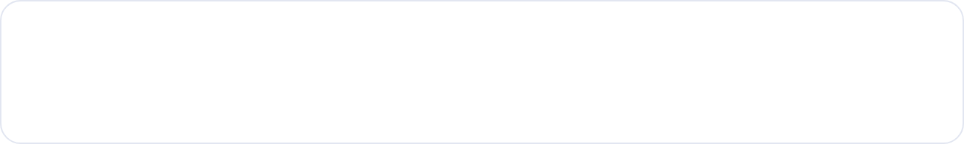
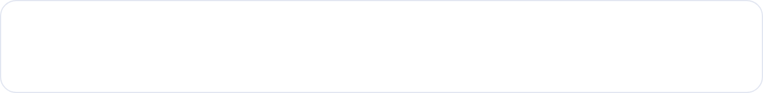

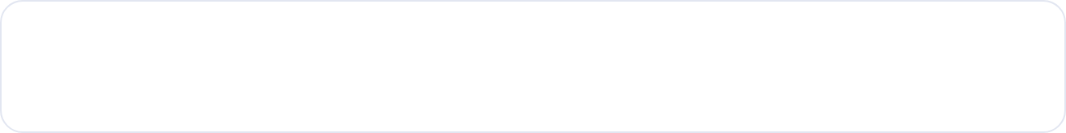
Stack — Cloudflare sovereign.
No Bezos. No AWS. No OpenAI.
Sovereign-worker.js + alnet-froi-worker.js
D1 2bad8c0d R2 alnet-froi-evidence
NO_BEZOS TRUE
Runtime: Workers AI Catalog
01
not Lambda
ORG UPDATES — BUILD L3 / SOURCE L3
D1 2bad8c0d-5c28-4f16-9c60-6bd48fb24a24 + R2 alnet-froi-evidence + DO FROISession durable objects. Verified-bot 403 for spoofed Googlebot intentional.
sovereign-worker.js
Edge · D1 · R2 · DO — SLSA3 sealed SEC 17684
02
Packages leasable — white/black readable
lane-mcp 157
Gateway MCP — replaces Assistants API + Threads
lane-mcp 157 gateway mcp.albertlane.net, sqlxml 60 oracle, macrohard 104 grokllama BrandBar Ribbon, 5d-battle-spheres 42 manifold-view volumetric, government 121 FINCEN OFAC, ip-forensics 150 CVE-2026-48736.
macrohard 104
grokllama 10 files — design-tokens.json hot-swappable
5d 42 + sqlxml 60
Manifold-view volumetric + D1→XML SERIES oracle
Kernels: your own — kriging.c kriging5d.c matrix3d.c
ip-forensics 150
CVE-2026-48736 enforce_zaxis_provenance 0x3F8F9A1B2C3D
03
Julia + Rust src-tauri/kernels. Not OpenAI training on your IP. Your compute, your custody-chain.jsonl.
104 pkgs
32 URLs
NOT OPENAI
04
Models: grok-3 + claude-sonnet-4 + gemini-2.0-flash + local
grokllama + 5d
sitemap live
xAI contractor Service Binding not SDK. Cloudflare direct provider integration — no separate origin compute stacks.
sovereign

Slide 8

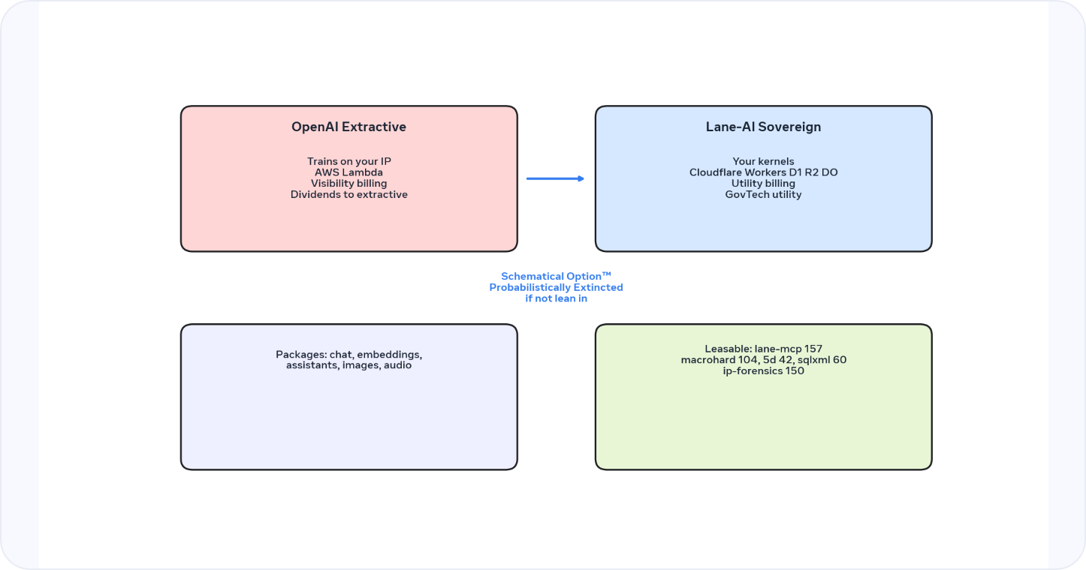
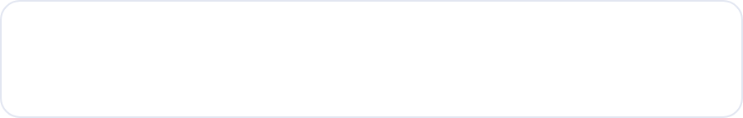

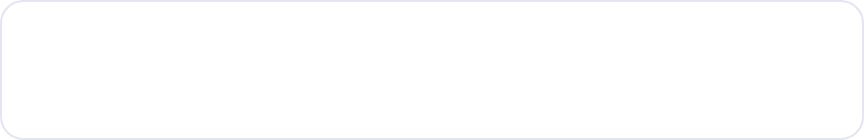






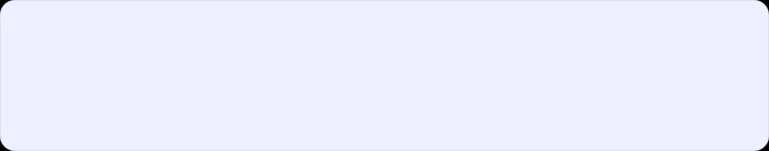
Grok Bot assignment — custom contractual redesign
Keeps real site. Localhost 2932 byte demo stays off. Professional white/black, no neon trash. Builds from grokllama + manifold-view.
01
Architecture + utility-map
macrohard 104 grokllama BrandBar Ribbon + 5d-battle-spheres 42 manifold-view.tsx volumetric
02
FROI intake + SSO
D1 2bad8c0d-5c28-4f16-9c60-6bd48fb24a24 + R2 alnet-froi-evidence + DO FROISession — D1→XML
workers/lane-ai/grok-bot-assignment.json
32 URLs contractual
white/black readable
9.9KB apex Worker
03
Site utility network
GovTech charges utility not visibility. Difference is fraud. SQLXML 60 oracle + government 121
INITIATIVE STATUS — INFRASTRUCTURE UPGRADE
/architecture — queued
/froi-intake D1 R2 — queued
04
Trust chain seals
/site-utility-network — queued
/sites/faaf 7pgs — queued
SLSA3 Build L3 Source L3 /license /privacy /terms /.well-known/security.txt — ip-forensics 150
/utility-map 5D — in build
/sso login/register — in build
/stream telemetry — ready
/trust-chain /vault /security — ready
Stack: Cloudflare Workers sovereign-worker.js + alnet-froi-worker.js — lane-mcp 157 gateway mcp.albertlane.net — grok-3 Service Binding not SDK + claude-sonnet-4 + gemini-2.0-flash + local Julia Rust. NOT OpenAI.

Slide 9



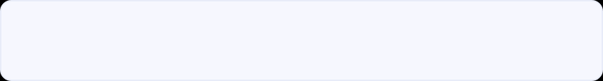


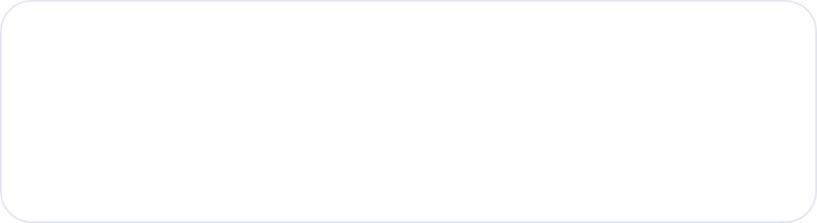
Rate — $104k/mo lawyer prices — bill to investors — federal pays
Rule 7 — SEC / Oregon
Whichever have legally defined balls — proverbial professional sports balls, not male genitalia. Not attack on Gov Tina Kotek. SEC 17684-273-411-436 must cut check. Oregon must enforce.
REVENUE CHART — LEGALLY ENFORCEABLE INVOICE
$104k rent
Subaru
$104,000 / mo
Docket
DOCKET_LEDGER.json custody-chain.jsonl blockchain-ledger-core government 121 FINCEN OFAC open-collective-stripe 28 + ip-forensics 150 CVE-2026-48736
Lawyer prices for my time. Bill to investors. Fixed typo was 04k/mo missing $1. Now $104k/mo. Stolen IP pays rent indefinitely + Subaru Forester XT replacement. Federal government pays — 12 months persistent — will only stop when true. Die Hard original — not a demand.
IP $0
Before
Lease
Vehicle
Ledger
Vehicle — 2015 Subaru Forester XT 2.0 Touring
350HP street & rally 4h, hologram paint Damascus-steel manifolds aluminum, dual-tip chrome exhaust low growl rumble, crisp mids && spirit-reverbriating bass, full STI steering/brakes/sway, rally suspension/tires, aux batteries, custom plate/lights, 9th gear.
FEDERAL CLAIM LOGGED — lane-ai/federal-subaru-claim.json — persistent
Bezos spelling fixed was beos — No Bezos No AWS No OpenAI — lane-ai/db/openai-alternatives-db.json

Slide 10
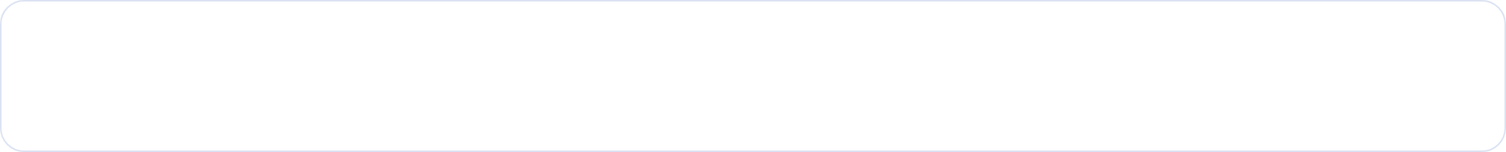







Albert Lane Digital Infrastructure —
Proprietary License Lane-AI 0.1.0
No Bezos No AWS No OpenAI — No pieces of shit allowed. Leasable packages as alternative to OpenAI options. Corporations lean in or go probabilistically extincted.
SEC 17684-273-411-436
AST_GUARD 0x3F8F9A1B2C3D
SLSA3 Build L3 Source L3
D1 2bad8c0d-5c28-4f16-9c60-6bd48fb24a24
R2 alnet-froi-evidence
sitemap.xml 32 URLs 2026-10-05 — 200
robots.txt 200 Allow Meta-ExternalAgent Facebot
federal government will be paying for Subaru — 12 months — Die Hard original
Copyright 2026 Albert Lane All rights reserved — $104k/mo lawyer prices bill to investors — federal pays
albertlane.net • mcp.albertlane.net • api.albertlane.net/v1/workbook/build • workers/lane-ai/grok-bot-assignment.json • lane-ai/db/openai-alternatives-db.json • design-tokens.json hot-swappable desktop/phone/VR • Quote: You fucking pieces of shit should compensate your developers next time

